Slide 1
AI Generated
Text Detection
(AI)

Slide 2
Table of contents
01
02
03
04
05
Introduction
Traditional Approaches
Existing Tools
ML based Approaches
Proposed method

Slide 3
01
Introduction
(AI)

Slide 4

AI Generated Text
AI generated content have been recently popular after publicly available LLMs(ChatGPT) which produce high quality text. But there are two main problems.
(a) Misinformation
AI generated text doesn’t have credibility because it doesn’t give any references about the sources where the information is retrieved from.
(b) Fraudulent activities
AI to create fake content at little cost, and experts say the output can do a better job fooling the public than human-created content.

Slide 5
AI Generated Text VS
Human Generated Text
AI generated text have some following features which could be used to distinguish from human text.
Formulaic structure
Specific patterns (watermarks)
Low Perplexity

Slide 6
02
Traditional Approaches

Slide 7
Using Statistical Metrics
These metrics provide quantitative insights into the linguistic characteristics of a text, and their values can often reveal patterns indicative of automated text generation
(a) Entropy -> Higher entropy of next word prediction suggest greater diversity, while lower values indicate more predictability.
(b) Perplexity -> Lower perplexity because they are designed to optimize word prediction, making them more predictable and coherent.
(c) n-gram frequency -> Machine-generated texts may have a higher frequency of specific n-grams because they can inadvertently replicate patterns present in their training data.

Slide 8
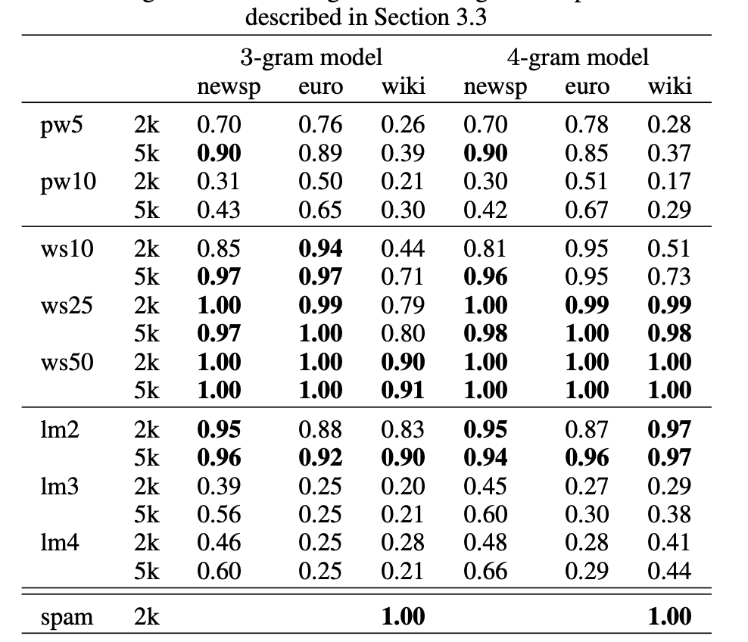
Detecting Fake Content with Relative Entropy Scoring
Markovian n-gram language models represent sequences of words. For instance, with a 3-gram model, the probability of a sequence of k > 2 words is given by:
p(w1 . . . wk) = p(w1)p(w2|w1) · · · p(wk|wk−2wk−1)
They used perplexities computed and the detection performed by thresholding these perplexities, where the threshold is tuned on some development data.
Lavergne, T., Urvoy, T. and Yvon, F., 2008. Detecting Fake Content with Relative Entropy Scoring. Pan, 8(27-31), p.4.

Slide 9
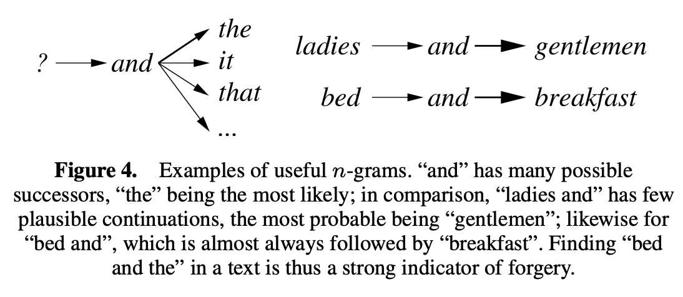
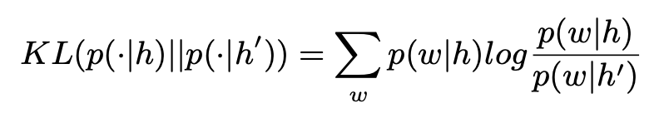
Detecting Fake Content with Relative Entropy Scoring
They used entropy-based detector uses a similar strategy to score n-grams according to the semantic relation between their first and last words.
This is done by finding useful n-grams, ie. n-grams, that can help detect fake content
Using the entropy scoring, if the score is higher, the text is AI generated and lower its AI generated.
This scoring method is not scalable because this scoring is expensive
Lavergne, T., Urvoy, T. and Yvon, F., 2008. Detecting Fake Content with Relative Entropy Scoring. Pan, 8(27-31), p.4.

Slide 10
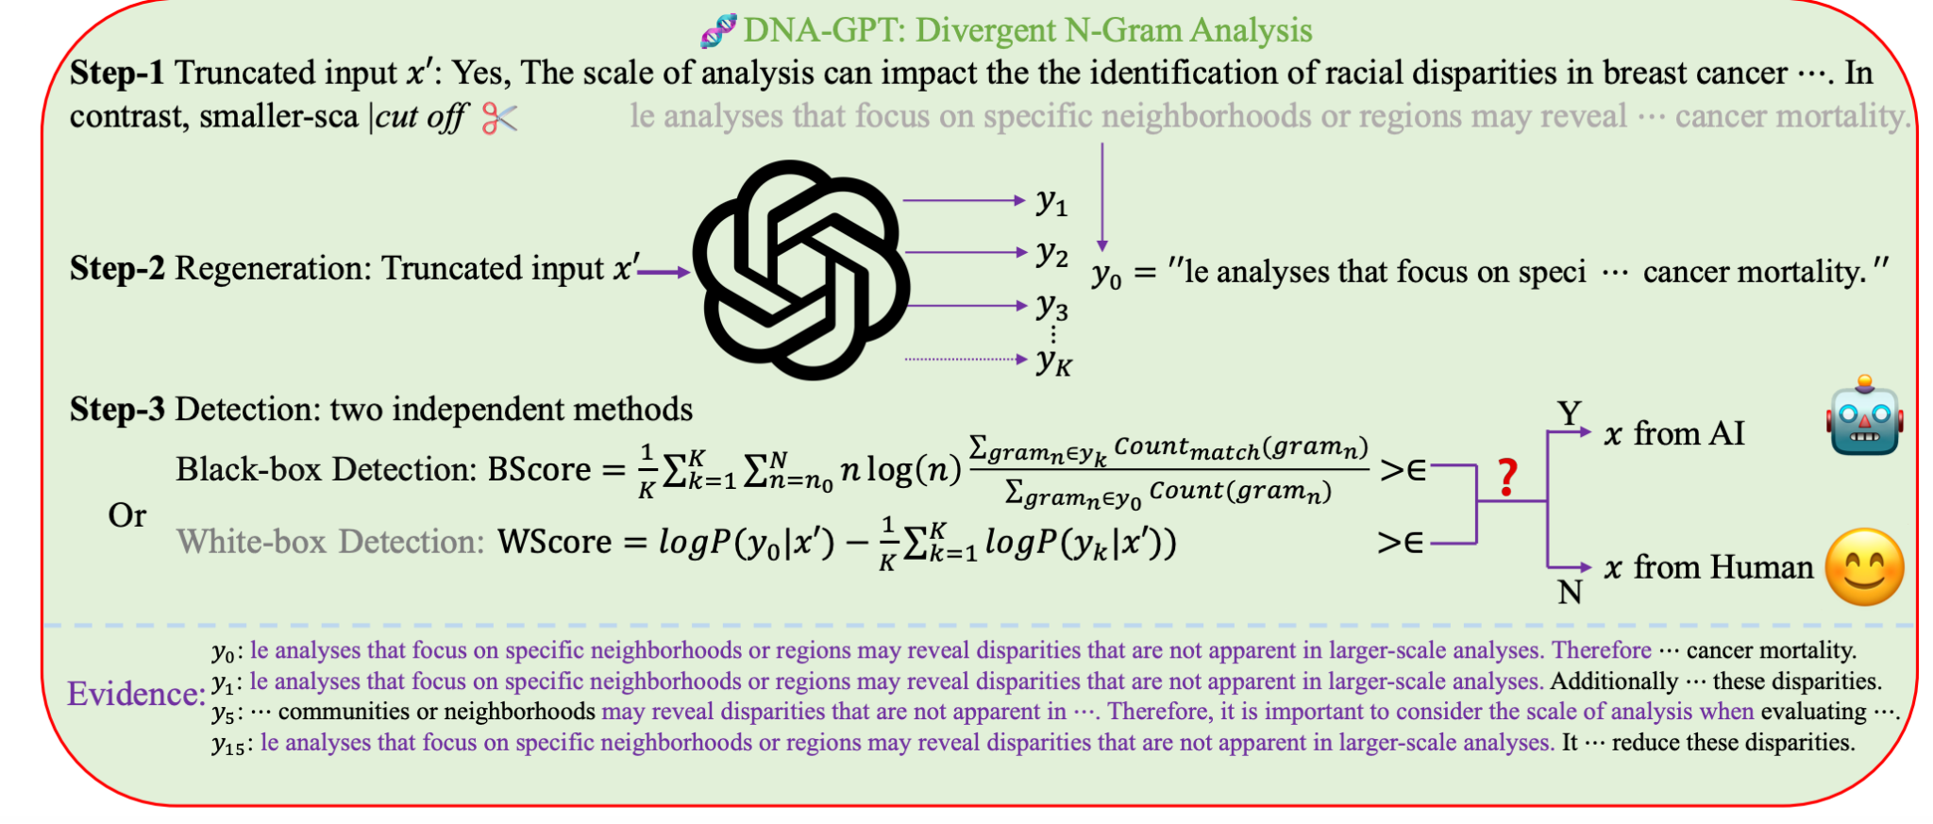
DNA-GPT: Divergent N-Gram Analysis for Training-Free Detection of GPT-Generated Text
Yang, X., Cheng, W., Petzold, L., Wang, W.Y. and Chen, H., 2023. DNA-GPT: Divergent N-Gram Analysis for Training-Free Detection of GPT-Generated Text. arXiv preprint arXiv:2305.17359.

Slide 11
DNA-GPT: Divergent N-Gram Analysis for Training-Free Detection of GPT-Generated Text
They conducted extensive experiments on the most advanced LLMs from OpenAI, including text-davinci-003, GPT-3.5-turbo, and GPT-4, as well as open-source models such as GPT-NeoX-20B and LLaMa-13B.
Training free flexible strategy
The entire method depends on GPT models, therefore scalability of this method is questionable for future
Yang, X., Cheng, W., Petzold, L., Wang, W.Y. and Chen, H., 2023. DNA-GPT: Divergent N-Gram Analysis for Training-Free Detection of GPT-Generated Text. arXiv preprint arXiv:2305.17359.

Slide 12
03
Existing Tools
(AI)
Notes:
When Talking about the Existing tools

Slide 13
Impact of Generative AIs
In November 2022, ChatGPT was launched.Within two months of its launch, it had over 100 million subscribers and was labelled “the fastest growing consumer app ever”
Notes:
With that there is a growing concern about the use of AI-generated content in academic settings. Students may use these tools to produce essays, reports, and other assignments, which can lead to unfair advantages and academic dishonesty.
Unfair use of AI-generated content can undermine the integrity of academic institutions, reduce the value of degrees, and harm the reputation of students and faculty

Slide 14
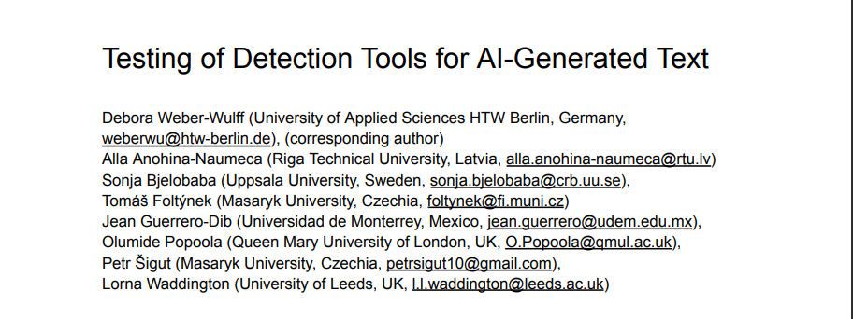
Testing of Detection Tools for AI-Generated Text
https://arxiv.org/ftp/arxiv/papers/2306/2306.15666.pdf
Notes:
The paper discuss about the evolution of Large language models and also the need of Detection Tools for AI-Generated Text about the accuracy of some online available tools Detecting AI-Generated Text and compared the accuracy among those tools

Slide 15
Research
Can existing detection tools reliably differentiate between human-written text and AI generated text?
Do machine translation and content obfuscation techniques affect the detection of AI-generated text?
Notes:
The study seeks to answer the following research questions:
1) Can existing detection tools reliably differentiate between human-written text and ChatGPT-generated text?
2) Do machine translation and content obfuscation techniques affect the detection of AI-generated text?
These questions are important because they help us understand the limitations of existing detection tools and identify areas for improvement.

Slide 16
References
The following 14 detection tools were tested
● Check For AI (https://checkforai.com)
● Compilatio (https://ai-detector.compilatio.net/)
● Content at Scale (https://contentatscale.ai/ai-content-detector/)
● Crossplag (https://crossplag.com/ai-content-detector/)
● DetectGPT (https://detectgpt.ericmitchell.ai/)
● Go Winston (https://gowinston.ai)
● GPT Zero (https://gptzero.me/)
● GPT-2 Output Detector Demo (https://openai-openai-detector.hf.space/)
● OpenAI Text Classifier (https://platform.openai.com/ai-text-classifier)
● PlagiarismCheck (https://plagiarismcheck.org/)
● Turnitin (https://demo-ai-writing-10.turnitin.com/home/)
● Writeful GPT Detector (https://x.writefull.com/gpt-detector)
● Writer (https://writer.com/ai-content-detector/)
● ZeroGPT (https://www.zerogpt.com/)
Notes:
The study tested 12 publicly available tools and two commercial systems (Turnitin and PlagiarismCheck) using an original document set. The researchers generated two documents with ChatGPT using different prompts and two additional texts of at least 2000 characters were generated using fresh prompts for ChatGPT, then the output was manipulated.

Slide 17
Dataset
● human-written (01-Hum)
● human-written in a non-English language with a subsequent AI/machine Translation to English (02-MT)
● AI-generated text (03-AI and 04-AI)
● AI-generated text with subsequent human manual edits (05-ManEd)
● AI-generated text with subsequent AI/machine paraphrase (06-Para)
Notes:
These will be the four situational parameters which were setted up for creating the test cases for the following categories of English-language
human-written (01-Hum)
human-written in a non-English language with a subsequent AI/machine Translation to English (02-MT)
AI-generated text using (03-AI and 04-AI) different prompts
AI-generated text with subsequent human manual edits (05-ManEd)
AI-generated text with subsequent AI/machine paraphrase (06-Para)

Slide 18
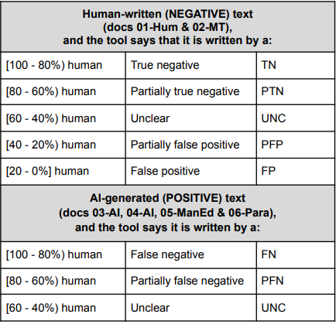
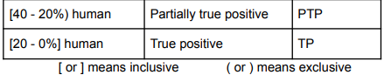
Evaluation
Notes:
This table indecates the evaluation criteria

Slide 19
Results

Slide 20
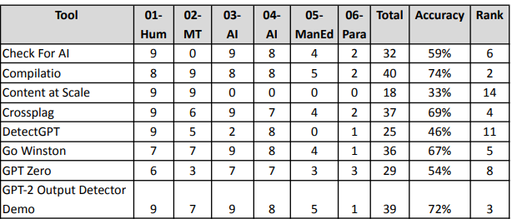
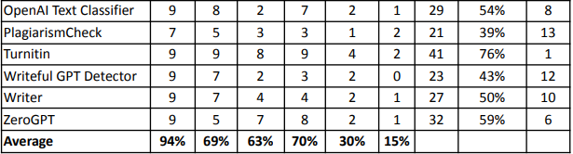
Accuracy of the detection tools (binary approach)
ACC_bin = (TN + TP) / (TN + PTN + TP + PTP + FN + PFN + FP + PFP + UNC)
Notes:
Accuracy of the detection tools (binary approach)

Slide 21
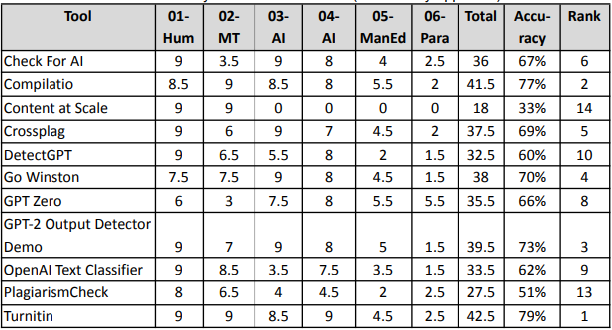
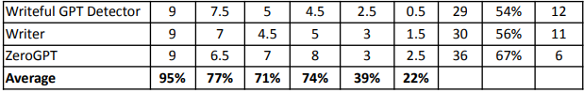
Accuracy of the detection tools(semi-binary approach)
ACC_SEMIBIN = (TN + TP + 0.5 × PTN + 0.5 × PTP) / (TN + PTN + TP + PTP + FN + PFN + FP + PFP + UNC)
Notes:
Accuracy of the detection tools(semi-binary approach)

Slide 22
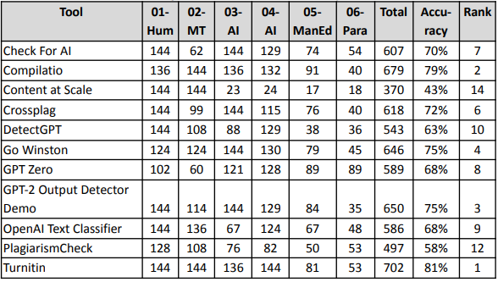
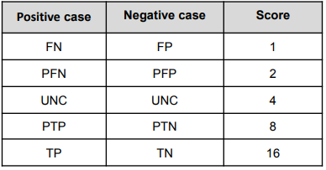
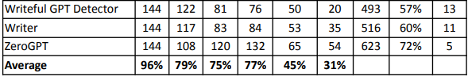
Logarithmic approach to accuracy evaluation
Notes:
Logarithmic approach to accuracy evaluation

Slide 23
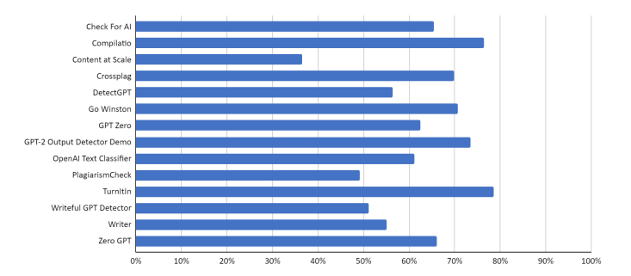
Overall accuracy for each tool calculated as an average of all approaches discussed
Notes:
The graph shows the average accuracy of each tools

Slide 24
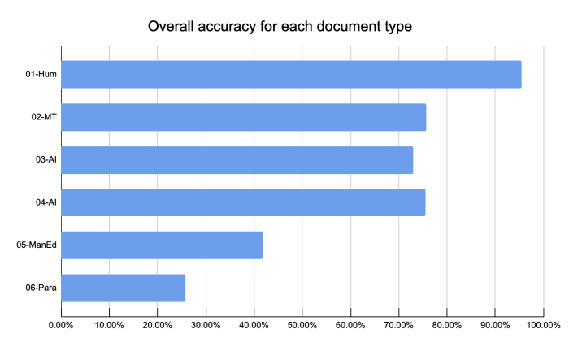
Overall accuracy for each document type (calculated as an average of all approaches discussed)
Notes:
This graph shows the average accuracy of each document type which is introduced before

Slide 25
04
ML based Approaches
(AI)

Slide 26
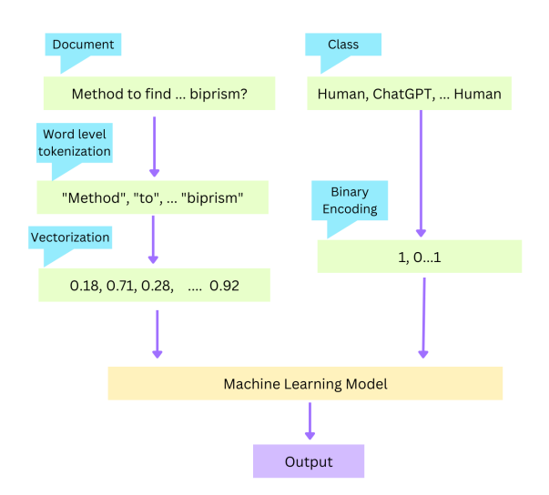
Classifier models

Slide 27
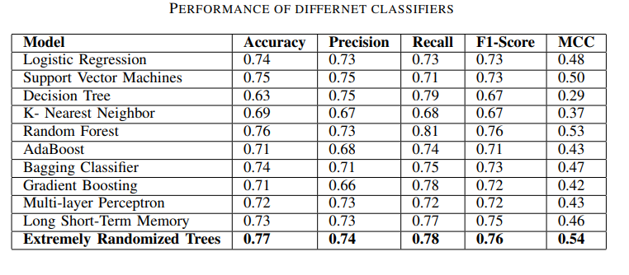
Comparison among basic supervised models
Distinguishing Human Generated Text From ChatGPT Generated Text Using Machine Learning (Islam, N., Sutradhar, D., Noor, H., Raya, J.T., Maisha, M.T. and Farid, D.M., 2023. Distinguishing Human Generated Text From ChatGPT Generated Text Using Machine Learning. arXiv preprint arXiv:2306.01761.)

Slide 28
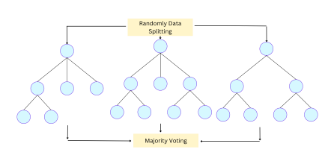
Extremely Randomized Trees model
Uses Term Frequency-Inverse Document Frequency (TF-IDF ) vectorizer
TF-IDF is to emphasize the important words
ERTC is an ensemble algorithm that is based on decision tree.
At testing, it takes majority voting for prediction.
the corpus generated by GPT-3.5
Published in 26 May 2023

Slide 29
Limitations
Computationally Intensive: Constructing multiple decision trees during the training phase and performing majority voting during testing can be computationally expensive, especially when dealing with a large number of trees and features.
Hyperparameter Tuning: As mentioned, there are several hyperparameters to tune, such as the number of decision trees (in this case, 50), splitting criteria (gini), and others. Finding the optimal set of hyperparameters can be time-consuming and requires expertise.

Slide 30
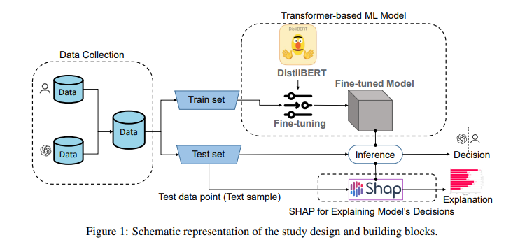
CHATGPT OR HUMAN? DETECT AND EXPLAIN. EXPLAINING DECISIONS OF MACHINE LEARNING MODEL FOR DETECTING SHORT CHATGPT-GENERATED TEXT
The main 2 steps :
1.have used the DistilBERT which is pre-trained for the sequence classification task to do classification of chatgpt generated text
2.SHAP for Explaining Model’s Decisions
( SHAP can help identify which words or
phrases in a given text are the most important
in determining the model’s output)
Mitrović, S., Andreoletti, D. and Ayoub, O., 2023. Chatgpt or human? detect and explain. explaining decisions of machine learning model for detecting short chatgpt-generated text. arXiv preprint arXiv:2301.13852.

Slide 31
CHATGPT OR HUMAN? DETECT AND EXPLAIN. EXPLAINING DECISIONS OF MACHINE LEARNING MODEL FOR DETECTING SHORT CHATGPT-GENERATED TEXT
Published in 30 Jan 2023
Achieves accuracy of 98% corpus for chatgpt Query text
Achieves accuracy of 79% corpus for chatgpt rephrase text
generated by GPT-3.5

Slide 32
Observations
ChatGPT tends to describe experiences rather than expressing feelings.
ChatGPT, unlike humans, refrains from using personal pronouns (no personal pronouns, no expressions of feelings)
ChatGPT tends to use uncommon (unusual) words.
Aggressive language and rude vocabs are never used by ChatGPT.
ChatGPT vocabulary is much more formal
misses colloquial terms and abbreviations (e.g. it never uses “&” instead of “and”).
ChatGPT quite repeats itself. A majority of reviews in the ChatGP Tquery dataset, starts with “the restaurant”, “this restaurant” or contains the word “restaurant”.
contain atypical words or language constructs (e.g. “inattentive”)

Slide 33

Limitations
Transformer based model discriminates better when the text is generated based on customer queries and not by rephrasing original human texts.
This model is applicable when the text is short.

Slide 34
05
Proposed Method

Slide 35
Intuition
To improve the accuracy, we have to consider the occurrence of the unique attributes(UA) of AI generated text based on the observations from SHAP in DistilBERT. The attributes are,
no personal pronouns
no expressions of feelings
use uncommon (unusual) words
no rude vocabs
more formal words
no colloquial terms and abbreviations (e.g. it never uses “&” instead of “and”).
By using the property Unique Attributes, we can improve the model.

Slide 36

Research Questions & Objectives
RQ: How can we quantify attribute information into the model?
RO: We have to define metric to identify existence of unique attributes
RQ: How can we achieve better performance?
RO: We use the existing best model with modifications to improve overall performance
RQ: How can we incorporate unique attribute information into the model?
RO: We have to train the model with loss that depicts this information

Slide 37
Derivation
We have to quantify above experiments in favour of increasing the discriminating power of DistillBert.
Step 1: Calculate the frequency of unique attributes
Why? : Quantify the existence of unique attributes
Step 2: Learnable λi coefficients.
Why? : These coefficients will be useful in identify contribution of each attribute category for the learning task. We don’t know the relationships, therefore we learn and update through a training process.
Step 3: Normalize the UAFS score by dividing by m and n
Why? : For machine learning purposes.

Slide 38
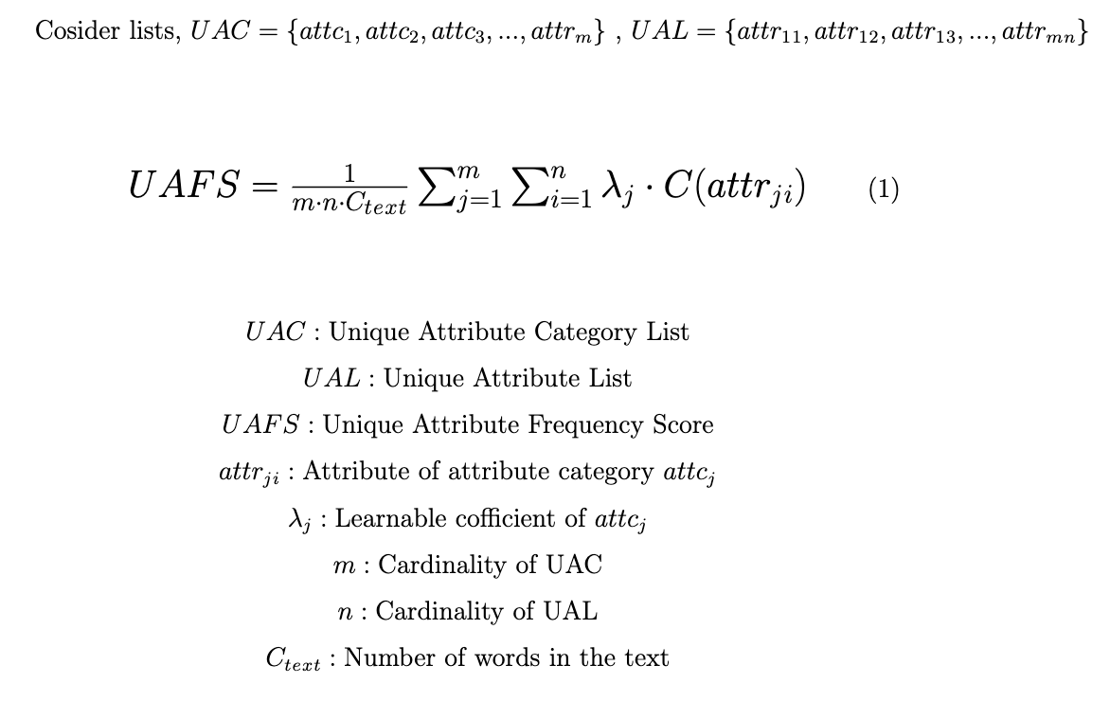
UAFS

Slide 39
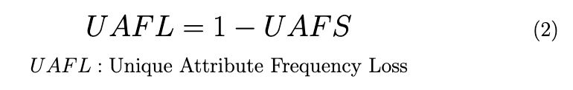
UAFL
We will derive the loss as follows,
By integrating the above loss with the existing approach mentioned, DistilBert during training and we can evaluate the model using the UAFS score with the learned parameters.

Slide 40
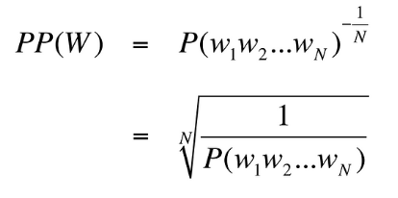
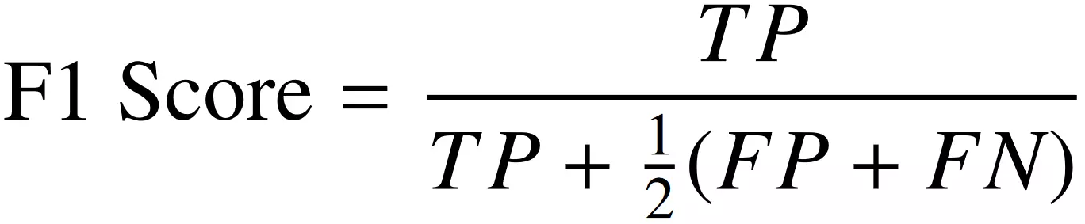
Evaluation Methods
Perplexity-based Classification
ML-based Classification
Calibrate with state of the art long text detection tools (turnitin (78%)
Distinguishing Human Generated Text From ChatGPT Generated Text Using Machine Learning (Islam, N., Sutradhar, D., Noor, H., Raya, J.T., Maisha, M.T. and Farid, D.M., 2023. Distinguishing Human Generated Text From ChatGPT Generated Text Using Machine Learning. arXiv preprint arXiv:2306.01761.)

Slide 41
Limitations
UAC and UAL creation needs human effort.
Initially, we will apply this loss for the DistillBERT on short text.
We need extensive experiments on short text before moving to long text. Then only we can move to long text
Training will be harder or model needs to trained for long time to

Slide 42
Thanks!

